Slide 1

Chapter 4
Digital Transmission
Copyright © The McGraw-Hill Companies, Inc. Permission required for reproduction or display.

Slide 2
4-2 ANALOG-TO-DIGITAL CONVERSION
A digital signal is superior to an analog signal because it is more robust to noise and can easily be recovered, corrected and amplified. For this reason, the tendency today is to change an analog signal to digital data. In this section we describe two techniques, pulse code modulation and delta modulation.
Topics discussed in this section:
Pulse Code Modulation (PCM)
Delta Modulation (DM)

Slide 3
PCM
PCM consists of three steps to digitize an analog signal:
Sampling
Quantization
Binary encoding
Before we sample, we have to filter the signal to limit the maximum frequency of the signal as it affects the sampling rate.
Filtering should ensure that we do not distort the signal, ie remove high frequency components that affect the signal shape.

Slide 4
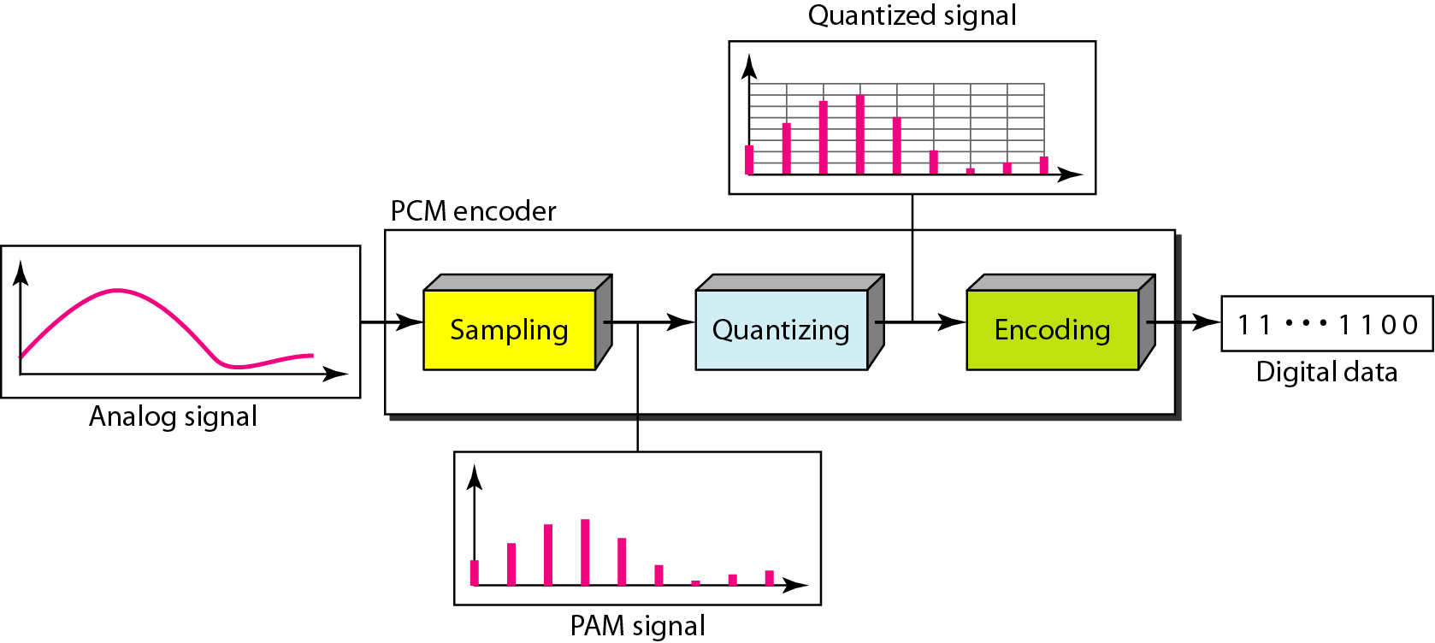
Figure 4.21 Components of PCM encoder

Slide 5
Sampling
Analog signal is sampled every T_{S} secs.
T_{s} is referred to as the sampling interval.
f_{s} = 1/T_{s} is called the sampling rate or sampling frequency.
There are 3 sampling methods:
Ideal - an impulse at each sampling instant
Natural - a pulse of short width with varying amplitude
Flattop - sample and hold, like natural but with single amplitude value
The process is referred to as pulse amplitude modulation PAM and the outcome is a signal with analog (non integer) values

Slide 6
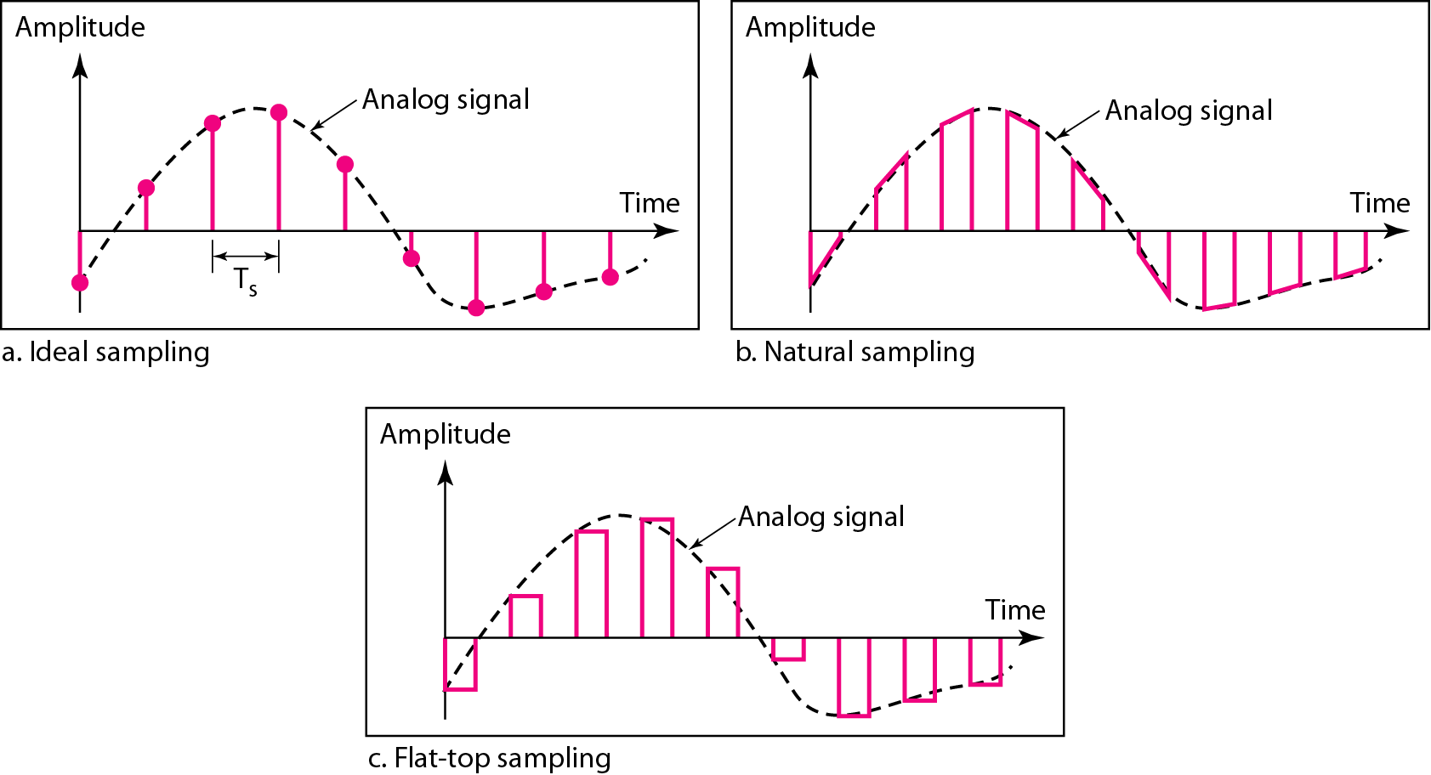
Figure 4.22 Three different sampling methods for PCM

Slide 7

Note
According to the Nyquist theorem, the sampling rate must be
at least 2 times the highest frequency contained in the signal.

Slide 8
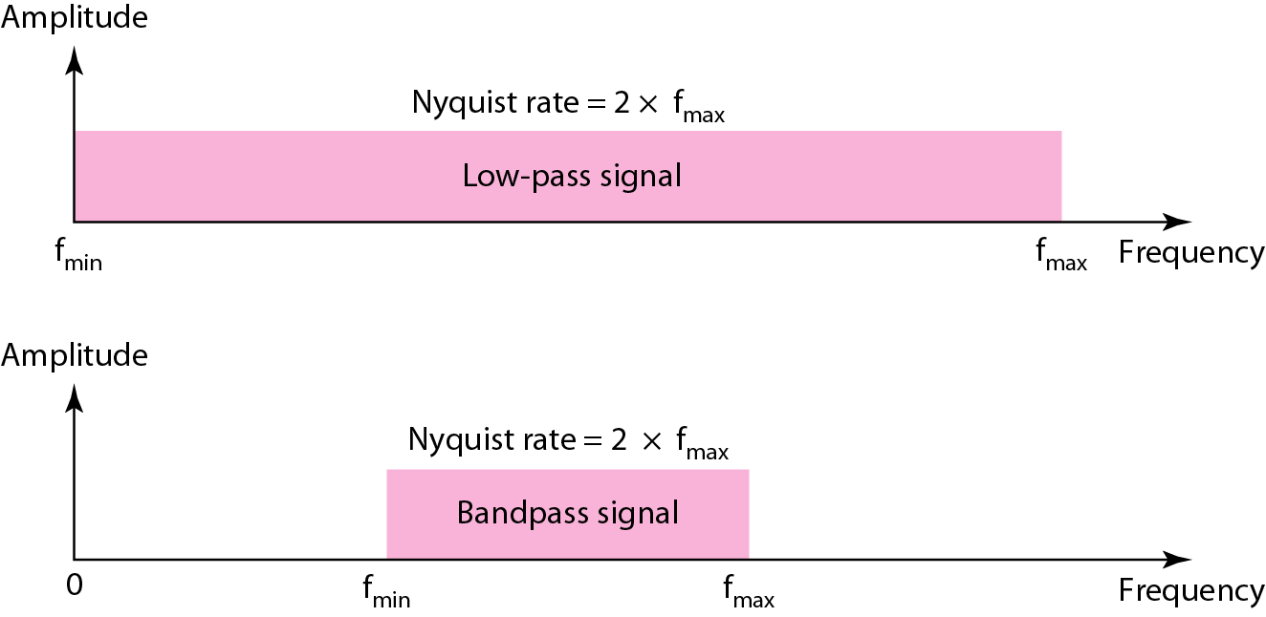
Figure 4.23 Nyquist sampling rate for low-pass and bandpass signals

Slide 9
Example 4.6
For an intuitive example of the Nyquist theorem, let us sample a simple sine wave at three sampling rates: f_{s} = 4f (2 times the Nyquist rate), f_{s} = 2f (Nyquist rate), and f_{s} = f (one-half the Nyquist rate). Figure 4.24 shows the sampling and the subsequent recovery of the signal.
It can be seen that sampling at the Nyquist rate can create a good approximation of the original sine wave (part a). Oversampling in part b can also create the same approximation, but it is redundant and unnecessary. Sampling below the Nyquist rate (part c) does not produce a signal that looks like the original sine wave.

Slide 10
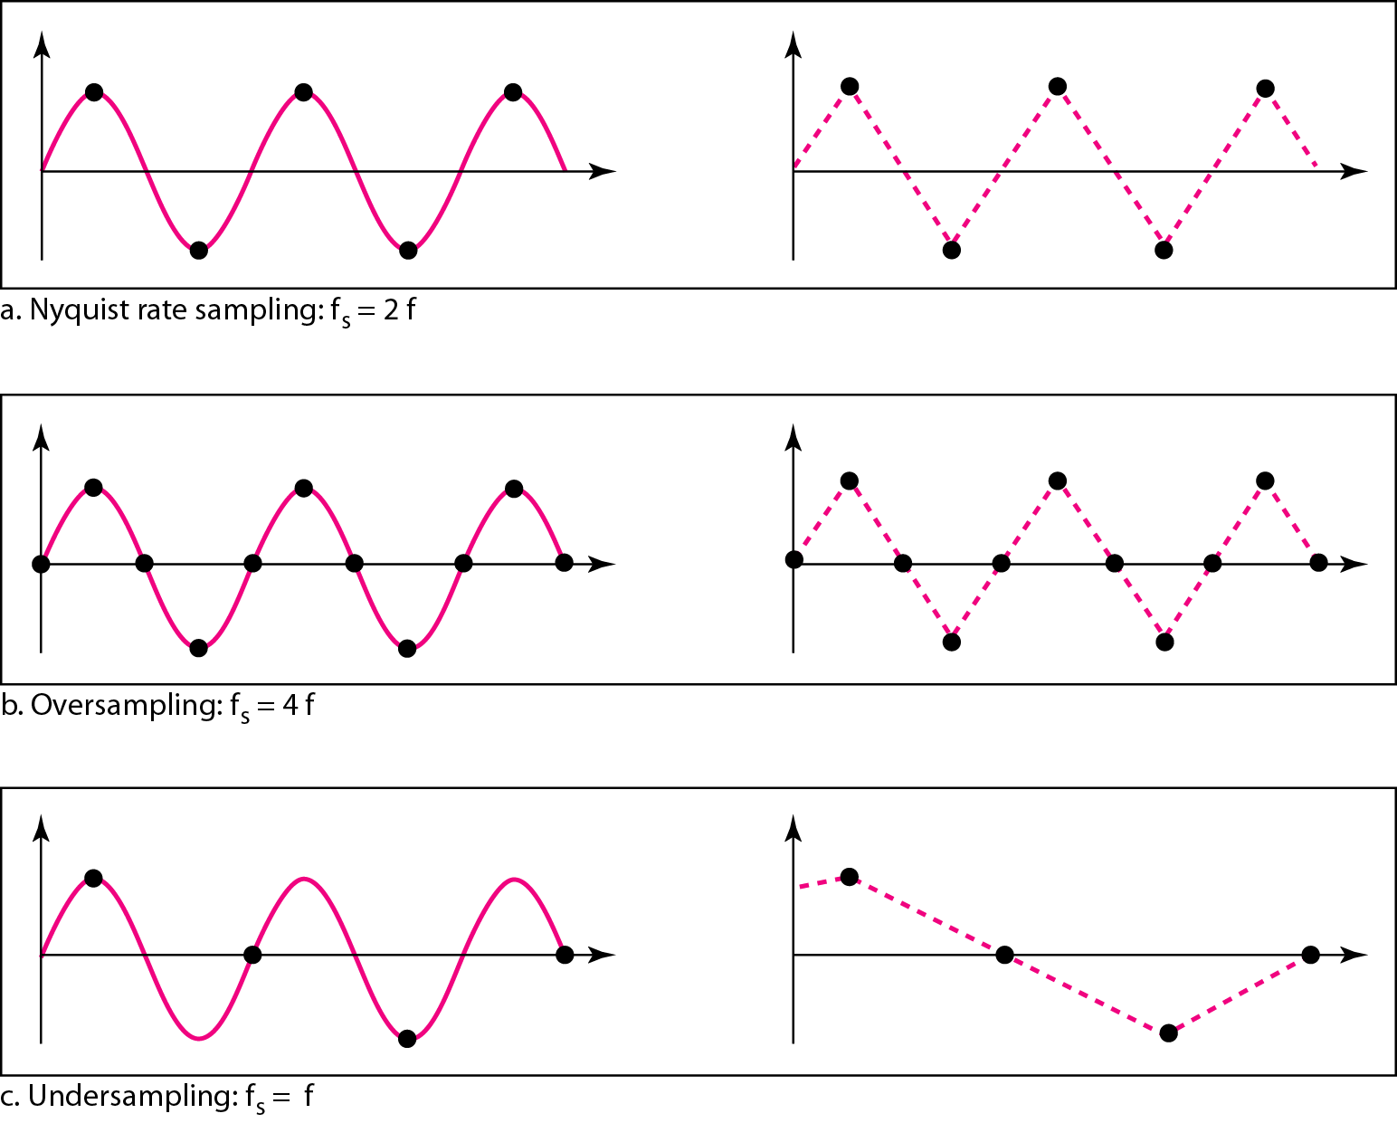
Figure 4.24 Recovery of a sampled sine wave for different sampling rates

Slide 11
Example 4.7
Consider the revolution of a hand of a clock. The second hand of a clock has a period of 60 s. According to the Nyquist theorem, we need to sample the hand every 30 s (T_{s} = T or f_{s} = 2f ). In Figure 4.25a, the sample points, in order, are 12, 6, 12, 6, 12, and 6. The receiver of the samples cannot tell if the clock is moving forward or backward. In part b, we sample at double the Nyquist rate (every 15 s). The sample points are 12, 3, 6, 9, and 12. The clock is moving forward. In part c, we sample below the Nyquist rate (T_{s} = T or f_{s} = f ). The sample points are 12, 9, 6, 3, and 12. Although the clock is moving forward, the receiver thinks that the clock is moving backward.

Slide 12
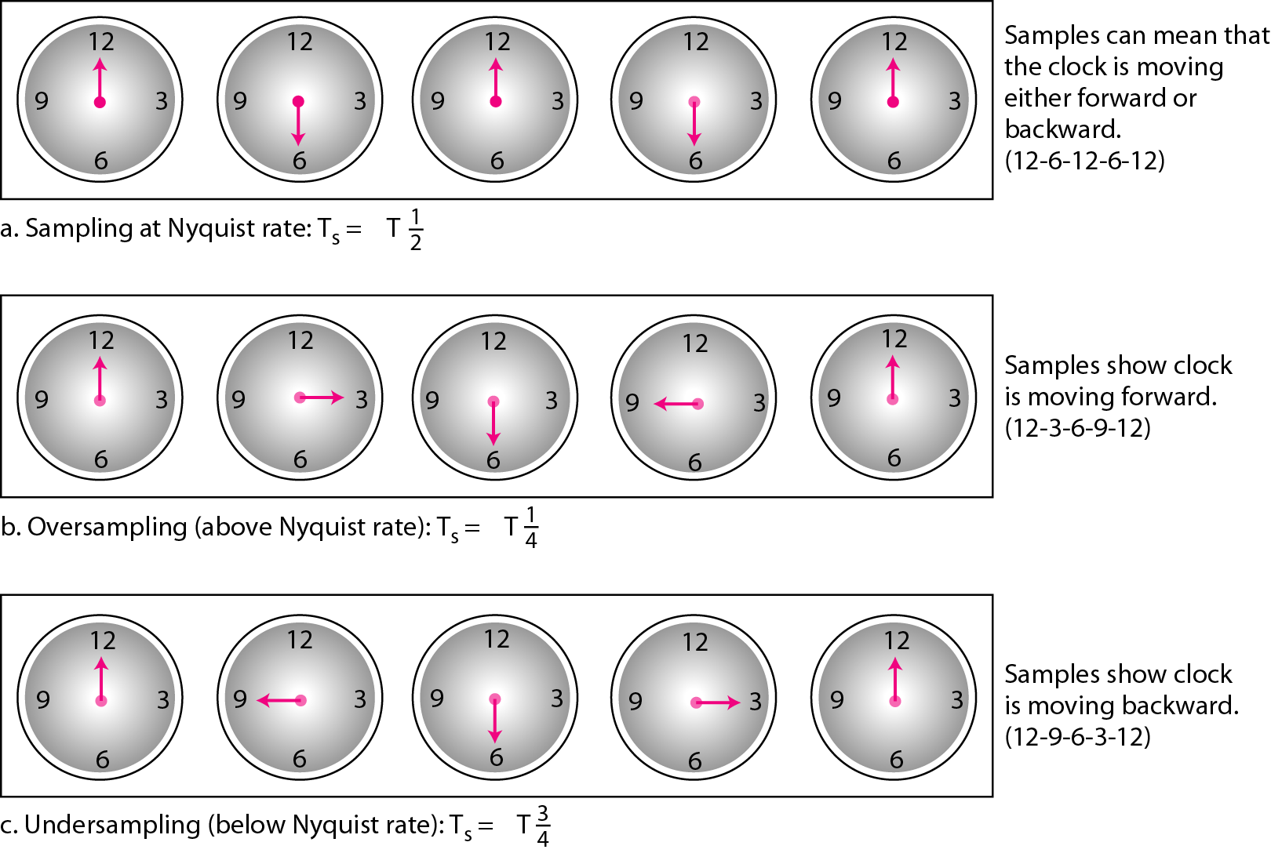
Figure 4.25 Sampling of a clock with only one hand

Slide 13
Example 4.8
An example related to Example 4.7 is the seemingly backward rotation of the wheels of a forward-moving car in a movie. This can be explained by under-sampling. A movie is filmed at 24 frames per second. If a wheel is rotating more than 12 times per second, the under-sampling creates the impression of a backward rotation.

Slide 14
Example 4.9
Telephone companies digitize voice by assuming a maximum frequency of 4000 Hz. The sampling rate therefore is 8000 samples per second.

Slide 15
Example 4.10
A complex low-pass signal has a bandwidth of 200 kHz. What is the minimum sampling rate for this signal?
Solution
The bandwidth of a low-pass signal is between 0 and f, where f is the maximum frequency in the signal. Therefore, we can sample this signal at 2 times the highest frequency (200 kHz). The sampling rate is therefore 400,000 samples per second.

Slide 16
Example 4.11
A complex bandpass signal has a bandwidth of 200 kHz. What is the minimum sampling rate for this signal?
Solution
We cannot find the minimum sampling rate in this case because we do not know where the bandwidth starts or ends. We do not know the maximum frequency in the signal.

Slide 17
Quantization
Sampling results in a series of pulses of varying amplitude values ranging between two limits: a min and a max.
The amplitude values are infinite between the two limits.
We need to map the infinite amplitude values onto a finite set of known values.
This is achieved by dividing the distance between min and max into L zones, each of height Δ.
Δ = (max - min)/L

Slide 18
Quantization Levels
The midpoint of each zone is assigned a value from 0 to L-1 (resulting in L values)
Each sample falling in a zone is then approximated to the value of the midpoint.

Slide 19
Quantization Zones
Assume we have a voltage signal with amplitutes V_{min}=-20V and V_{max}=+20V.
We want to use L=8 quantization levels.
Zone width Δ = (20 - -20)/8 = 5
The 8 zones are: -20 to -15, -15 to -10, -10 to -5, -5 to 0, 0 to +5, +5 to +10, +10 to +15, +15 to +20
The midpoints are: -17.5, -12.5, -7.5, -2.5, 2.5, 7.5, 12.5, 17.5

Slide 20
Assigning Codes to Zones
Each zone is then assigned a binary code.
The number of bits required to encode the zones, or the number of bits per sample as it is commonly referred to, is obtained as follows:
n_{b} = log₂ L
Given our example, n_{b} = 3
The 8 zone (or level) codes are therefore: 000, 001, 010, 011, 100, 101, 110, and 111
Assigning codes to zones:
000 will refer to zone -20 to -15
001 to zone -15 to -10, etc.

Slide 21
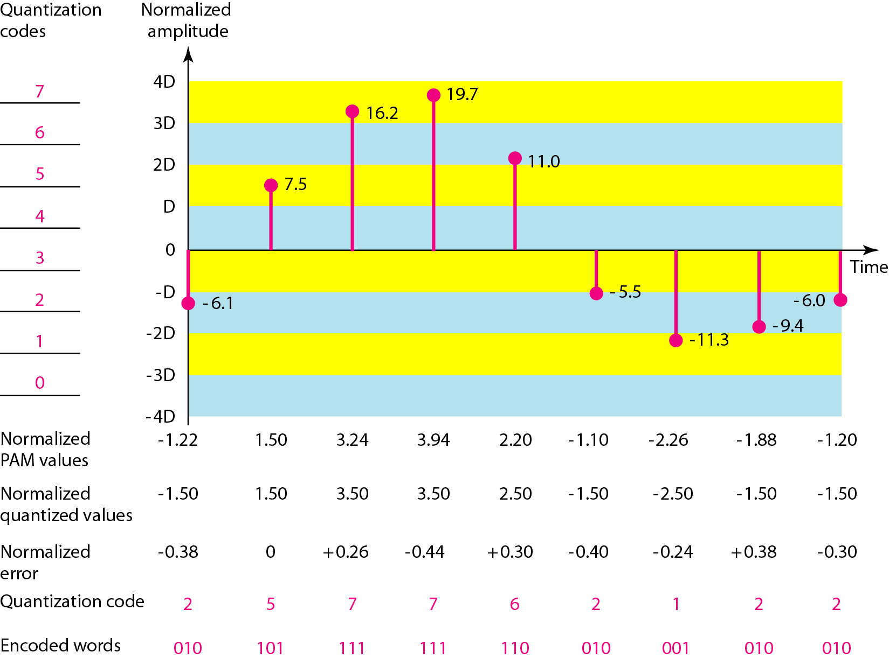
Figure 4.26 Quantization and encoding of a sampled signal

Slide 22
Quantization Error
When a signal is quantized, we introduce an error - the coded signal is an approximation of the actual amplitude value.
The difference between actual and coded value (midpoint) is referred to as the quantization error.
The more zones, the smaller Δ which results in smaller errors.
BUT, the more zones the more bits required to encode the samples -> higher bit rate

Slide 23
Quantization Error and SN_{Q}R
Signals with lower amplitude values will suffer more from quantization error as the error range: Δ/2, is fixed for all signal levels.
Non linear quantization is used to alleviate this problem. Goal is to keep SN_{Q}R fixed for all sample values.
Two approaches:
The quantization levels follow a logarithmic curve. Smaller Δ’s at lower amplitudes and larger Δ’s at higher amplitudes.
Companding: The sample values are compressed at the sender into logarithmic zones, and then expanded at the receiver. The zones are fixed in height.

Slide 24
Bit rate and bandwidth requirements of PCM
The bit rate of a PCM signal can be calculated form the number of bits per sample x the sampling rate
Bit rate = n_{b} x f_{s}
The bandwidth required to transmit this signal depends on the type of line encoding used. Refer to previous section for discussion and formulas.
A digitized signal will always need more bandwidth than the original analog signal. Price we pay for robustness and other features of digital transmission.

Slide 25
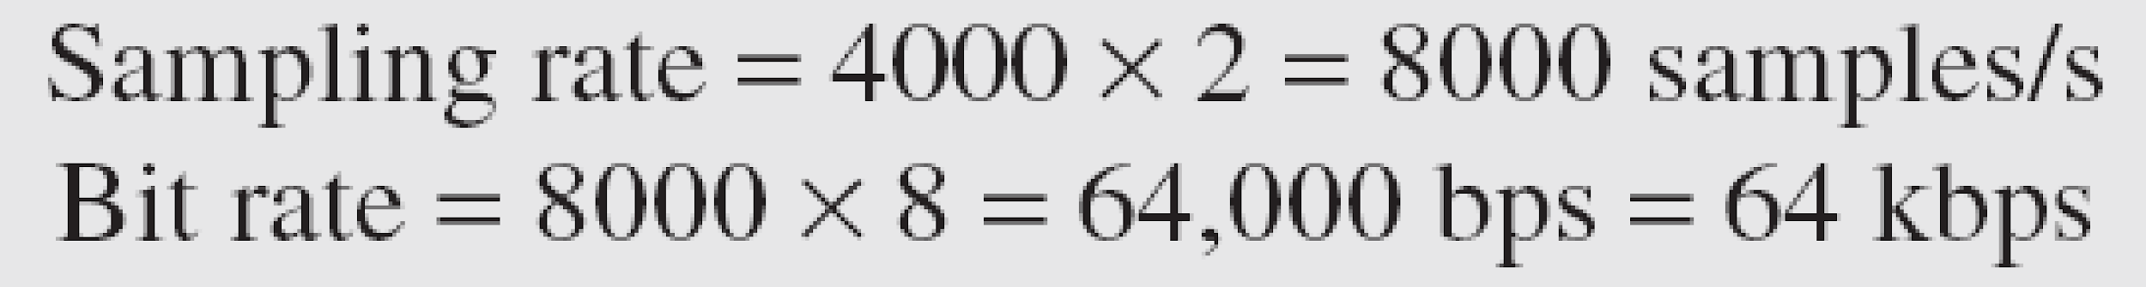
Example 4.14
We want to digitize the human voice. What is the bit rate, assuming 8 bits per sample?
Solution
The human voice normally contains frequencies from 0 to 4000 Hz. So the sampling rate and bit rate are calculated as follows:

Slide 26
PCM Decoder
To recover an analog signal from a digitized signal we follow the following steps:
We use a hold circuit that holds the amplitude value of a pulse till the next pulse arrives.
We pass this signal through a low pass filter with a cutoff frequency that is equal to the highest frequency in the pre-sampled signal.
The higher the value of L, the less distorted a signal is recovered.

Slide 27
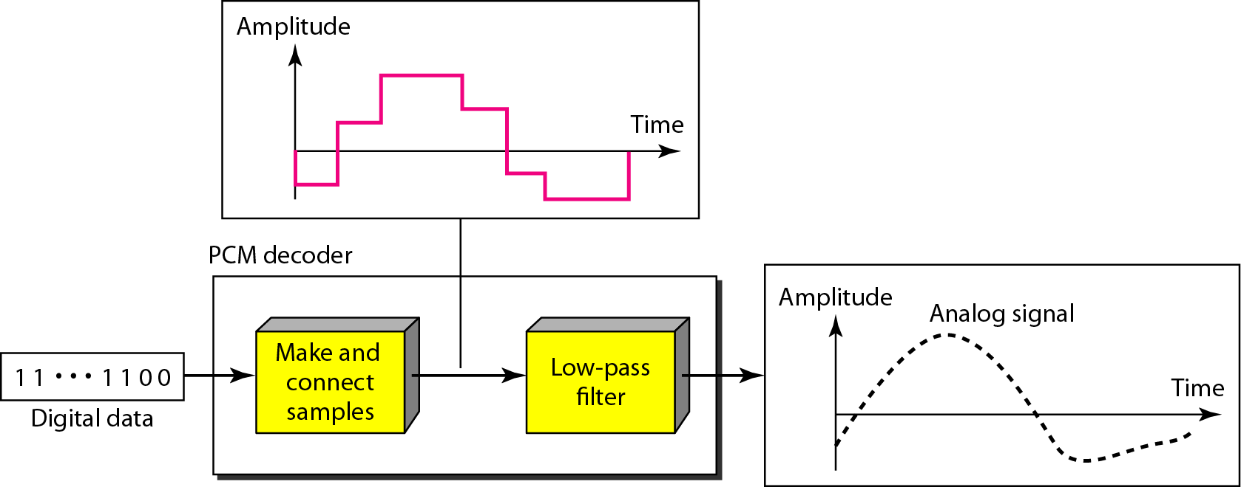
Figure 4.27 Components of a PCM decoder

Slide 28
Example 4.15
We have a low-pass analog signal of 4 kHz. If we send the analog signal, we need a channel with a minimum bandwidth of 4 kHz. If we digitize the signal and send 8 bits per sample, we need a channel with a minimum bandwidth of 8 × 4 kHz = 32 kHz.

Slide 29
Delta Modulation
This scheme sends only the difference between pulses, if the pulse at time t_{n+1} is higher in amplitude value than the pulse at time t_{n}, then a single bit, say a “1”, is used to indicate the positive value.
If the pulse is lower in value, resulting in a negative value, a “0” is used.
This scheme works well for small changes in signal values between samples.
If changes in amplitude are large, this will result in large errors.

Slide 30
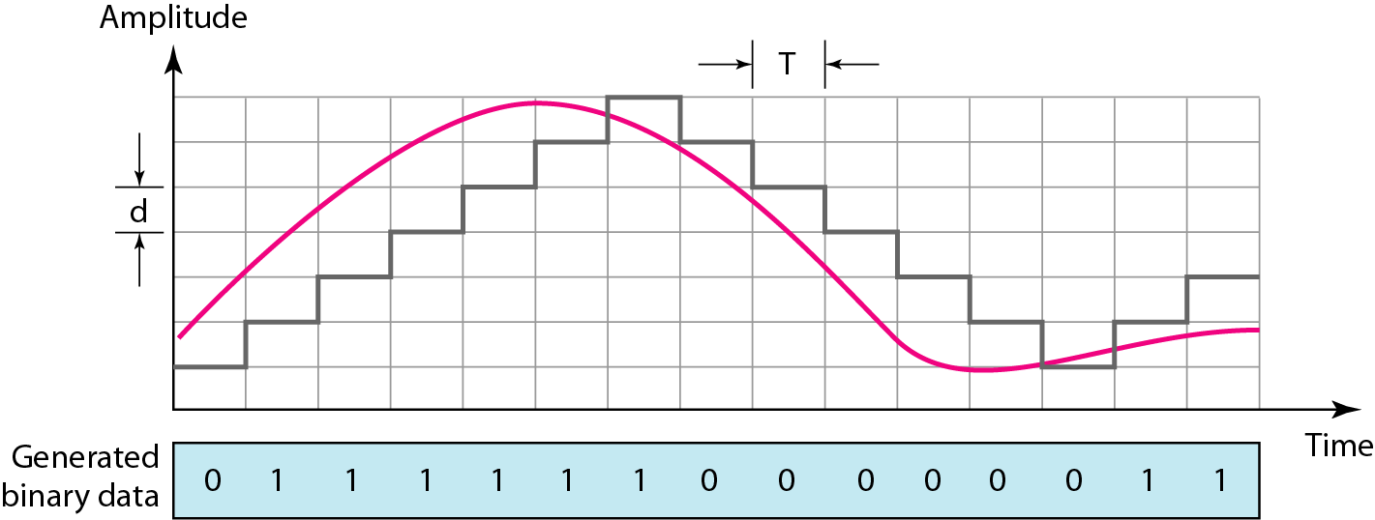
Figure 4.28 The process of delta modulation

Slide 31
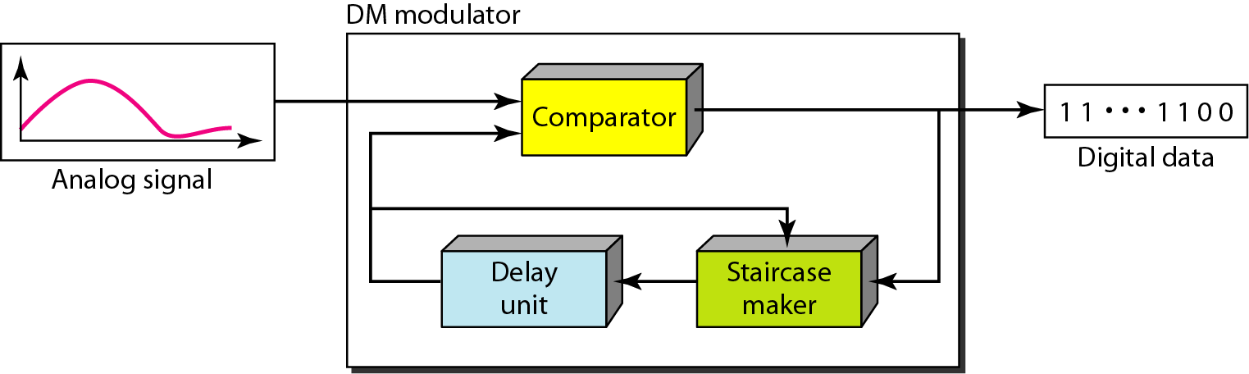
Figure 4.29 Delta modulation components

Slide 32
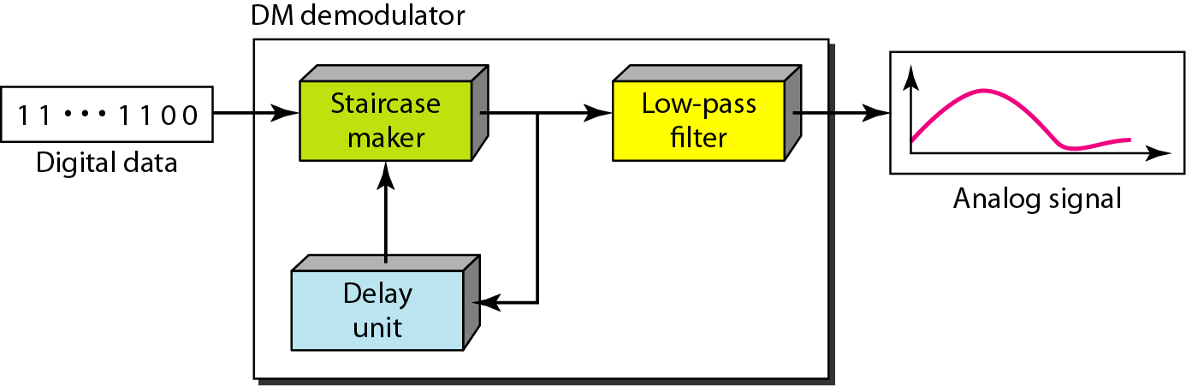
Figure 4.30 Delta demodulation components

Slide 33
Delta PCM (DPCM)
Instead of using one bit to indicate positive and negative differences, we can use more bits -> quantization of the difference.
Each bit code is used to represent the value of the difference.
The more bits the more levels -> the higher the accuracy.

Slide 34
4-3 TRANSMISSION MODES
The transmission of binary data across a link can be accomplished in either parallel or serial mode. In parallel mode, multiple bits are sent with each clock tick. In serial mode, 1 bit is sent with each clock tick. While there is only one way to send parallel data, there are three subclasses of serial transmission: asynchronous, synchronous, and isochronous.
Topics discussed in this section:
Parallel Transmission
Serial Transmission

Slide 35
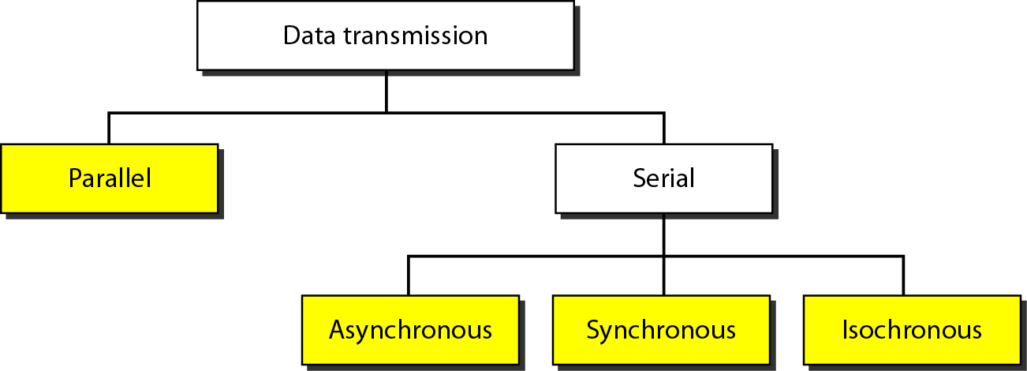
Figure 4.31 Data transmission and modes

Slide 36
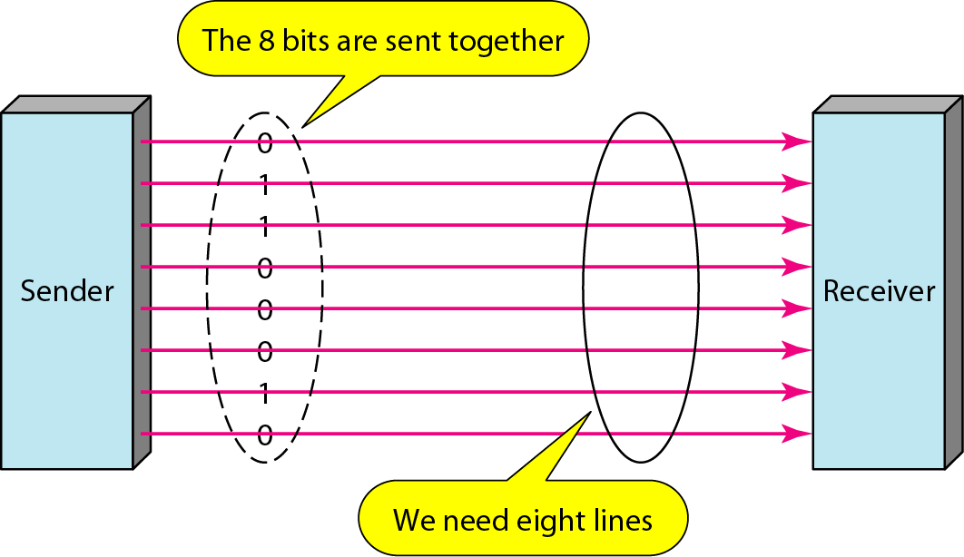
Figure 4.32 Parallel transmission

Slide 37
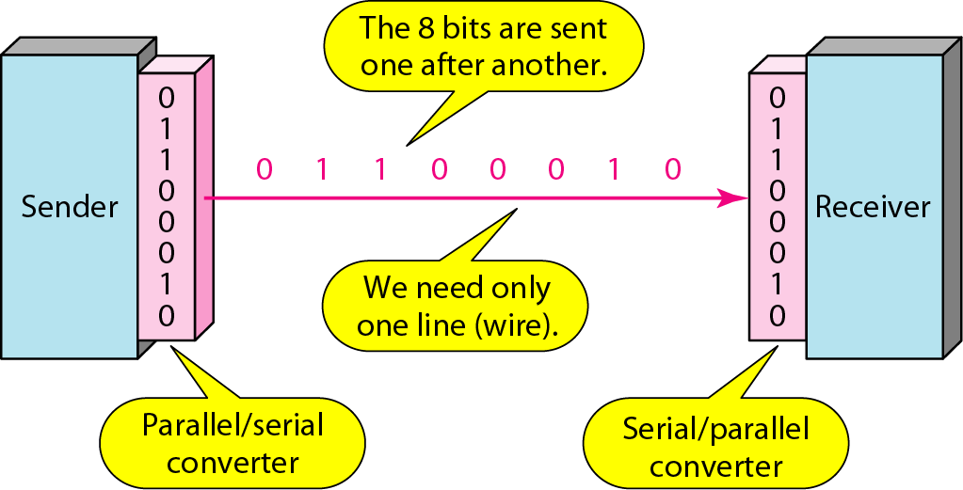
Figure 4.33 Serial transmission

Slide 38
Note
In asynchronous transmission, we send 1 start bit (0) at the beginning and 1 or more stop bits (1s) at the end of each byte. There may be a gap between each byte.

Slide 39
Note
Asynchronous here means “asynchronous at the byte level,”
but the bits are still synchronized; their durations are the same.

Slide 40
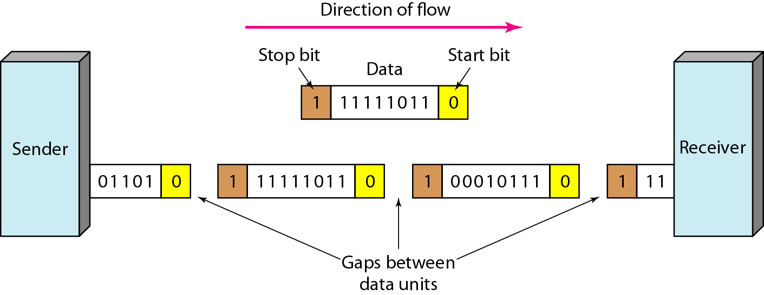
Figure 4.34 Asynchronous transmission

Slide 41
Note
In synchronous transmission, we send bits one after another without start or stop bits or gaps. It is the responsibility of the receiver to group the bits. The bits are usually sent as bytes and many bytes are grouped in a frame. A frame is identified with a start and an end byte.

Slide 42
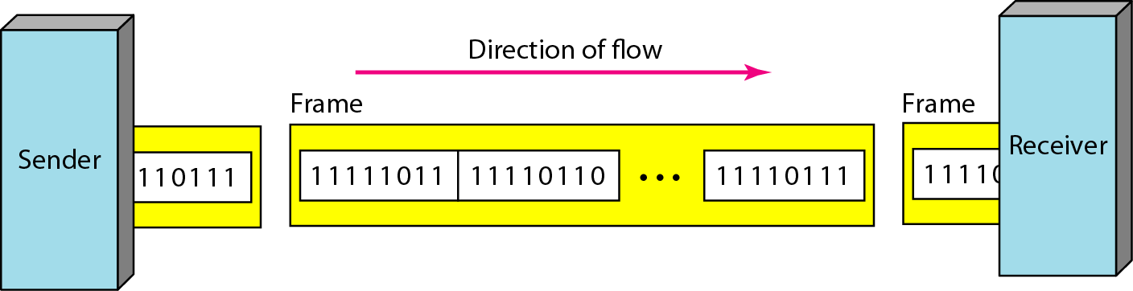
Figure 4.35 Synchronous transmission

Slide 43
Isochronous
In isochronous transmission we cannot have uneven gaps between frames.
Transmission of bits is fixed with equal gaps.

